Slide 1
Semantic Data Retrieval
CECS-571 Fundamentals of Semantic Web Technologies
Project 3
Team:
Aayoush Aayoush
Krutika Pathak
Mamta Pednekar
Shiva Singh
Sushma Kallapur
Git Link: https://github.com/krutikapathak/SemanticsFinalProject

Slide 2
Quick Reminder
The data sets have been used from Project 2.
We built Crash ontology which consists of vehicle and individual related information involved in the crash.
Data sets chosen from data.gov.
Year : 2018
Format : CSV

Slide 3
DataSets
The following two datasets that provide data for the vehicle crashes and the individuals involved were selected:
Motor_Vehicle_Crashes_-_Vehicle_Information__Three_Year_Window.csv
Attributes about each vehicle involved in a crash as reported to New York State DMV.
Motor_Vehicle_Crashes_-_Individual_Information__Three_Year_Window.csv
Attributes about each individual involved in a crash as reported to New York State DMV.

Slide 4
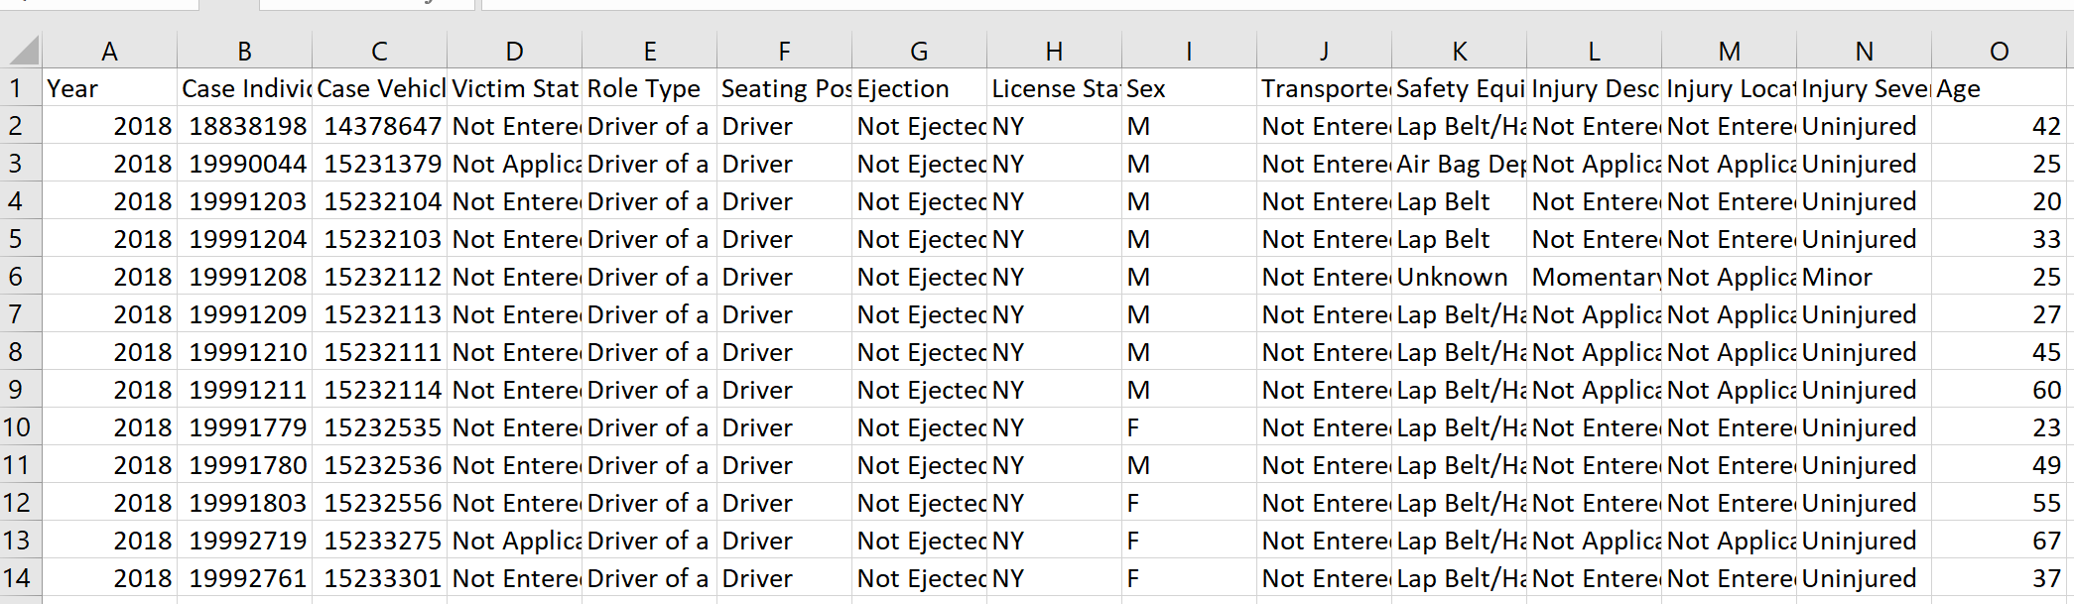
Sample Data
Individual

Slide 5
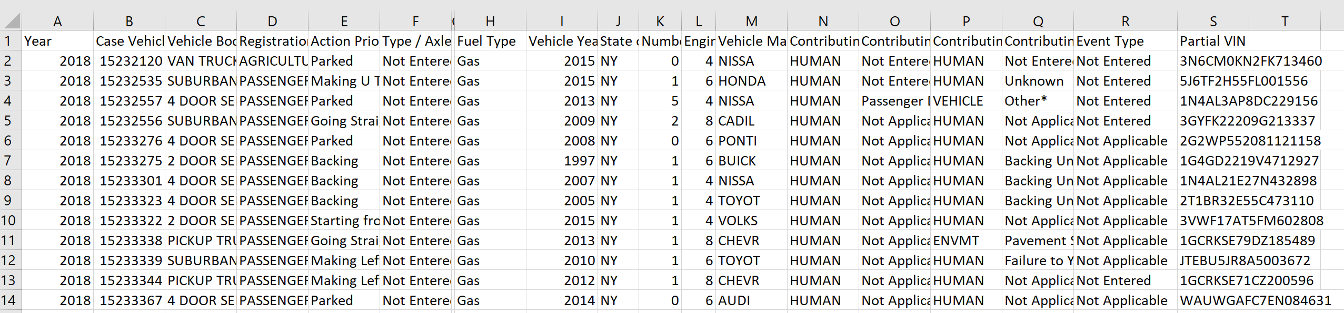
Sample data
Vehicle

Slide 6
Ontology Design

Slide 7
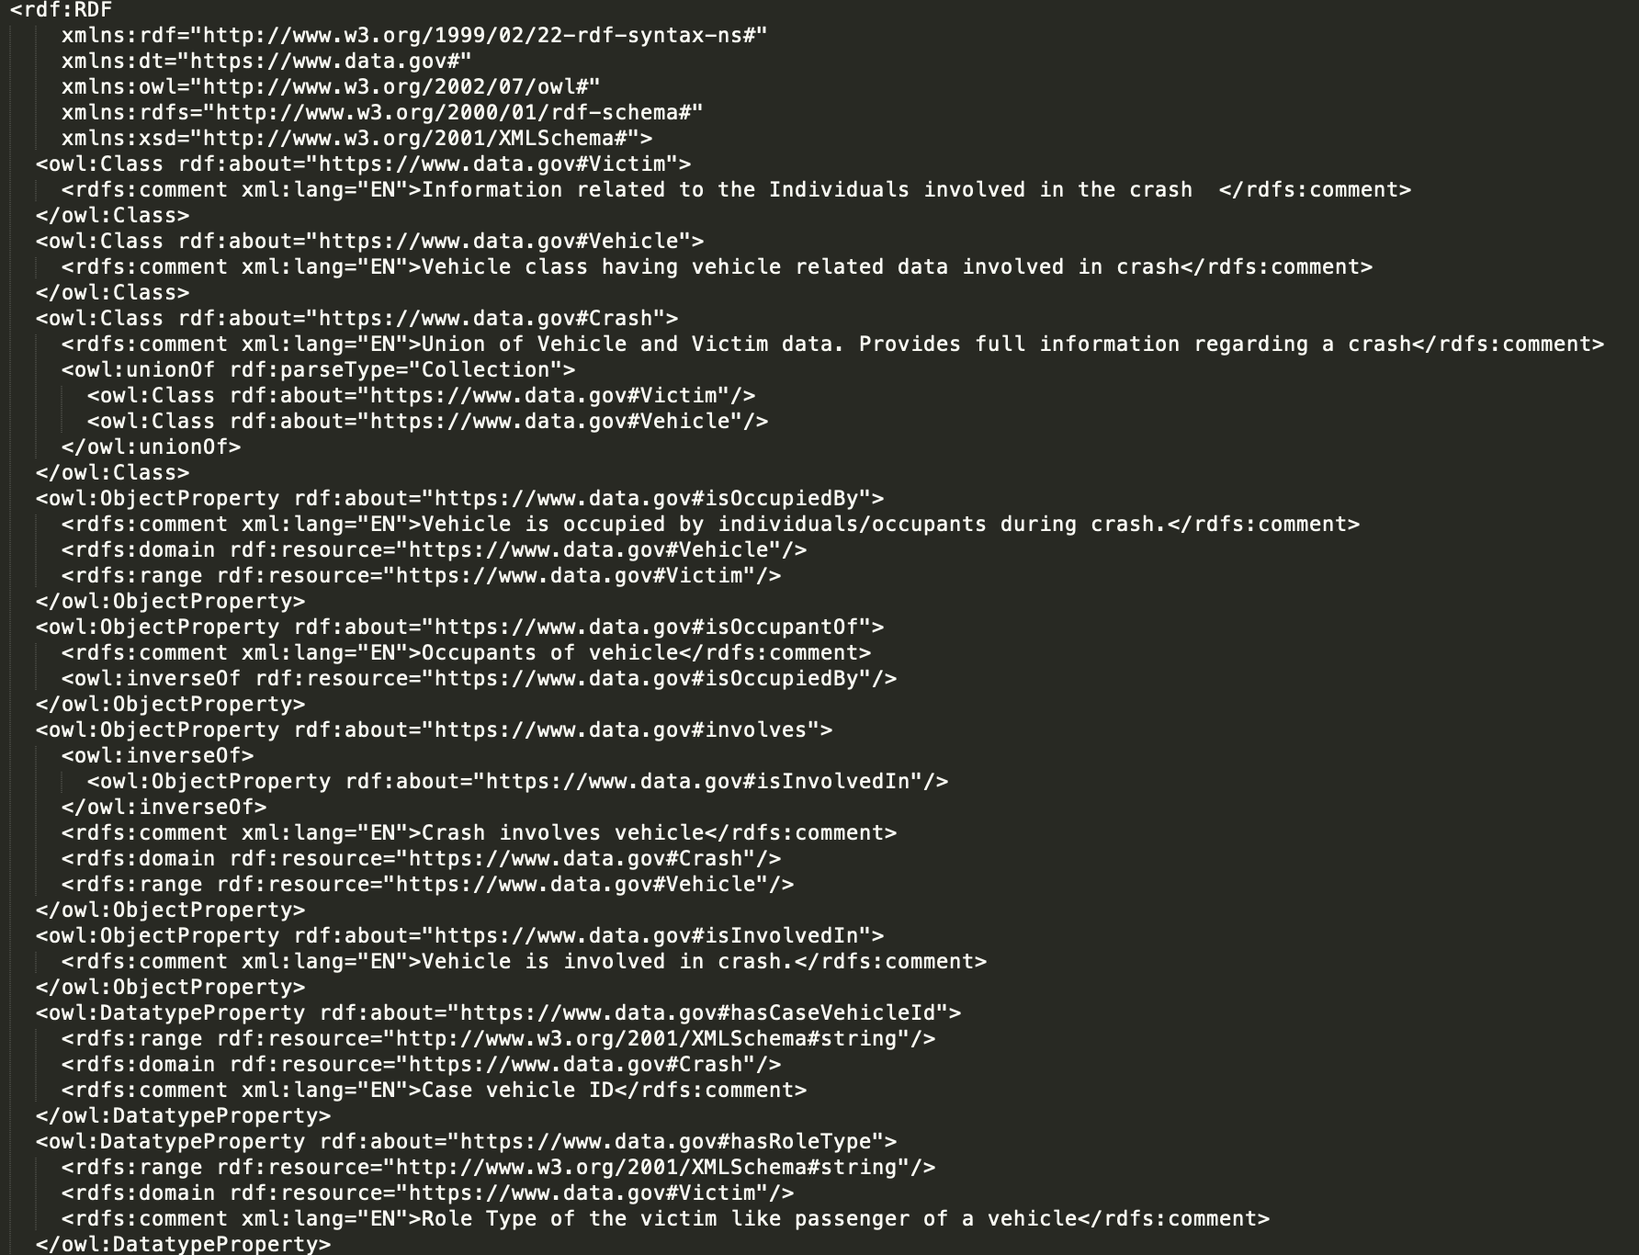
OWL File

Slide 8
OWL File

Slide 9
Technical Approach: An Overview
Step 1 : User Interface Design and Development using JSP and CSS.
Step 2 : Creation of SPARQL Queries.
Step 3 : Read OWL file and generate the model.
Step 4: Process the queries using Apache Jena.
Step 5: Integrate the final code to display the results in UI.
Step 6: Deploy and run the application on TOMCAT server.

Slide 10
Code Snippets

Slide 11
Query 1
PREFIX rdf: <http://www.w3.org/1999/02/22-rdf-syntax-ns#>
PREFIX rdfs: <http://www.w3.org/2000/01/rdf-schema#>
PREFIX owl: <http://www.w3.org/2002/07/owl#>
PREFIX xsd: <http://www.w3.org/2001/XMLSchema#>
PREFIX dt: <https://www.data.gov#>
SELECT ?Body_Type (ROUND(?Severe_Injury_Count * 100 / ?Total_Injury_Count) AS ?Severe_Injury_Percentage) ?Severe_Injury_Count ?Total_Injury_Count
WHERE {
{
SELECT ?Body_Type (COUNT(?Injury_Severity) AS ?Severe_Injury_Count)
WHERE {
?Crash dt:involves ?Vehicle .
?Vehicle dt:hasBodyType ?Body_Type .
?Vehicle dt:isOccupiedBy ?Victim .
?Victim dt:hasInjurySeverity ?Injury_Severity .
FILTER (?Injury_Severity = "Severe" || ?Injury_Severity = "Killed")
}
GROUP BY ?Body_Type
}
{
SELECT ?Body_Type (COUNT(?Body_Type) AS ?Total_Injury_Count)
WHERE {
?Crash dt:involves ?Vehicle .
?Vehicle dt:hasBodyType ?Body_Type .
}
GROUP BY (?Body_Type)
HAVING (?Total_Injury_Count > 10)
}
}
ORDER BY DESC(?Severe_Injury_Percentage)
According to the crash data of New York state, what is the percentage of severe injuries for different Vehicle Body Types?

Slide 12
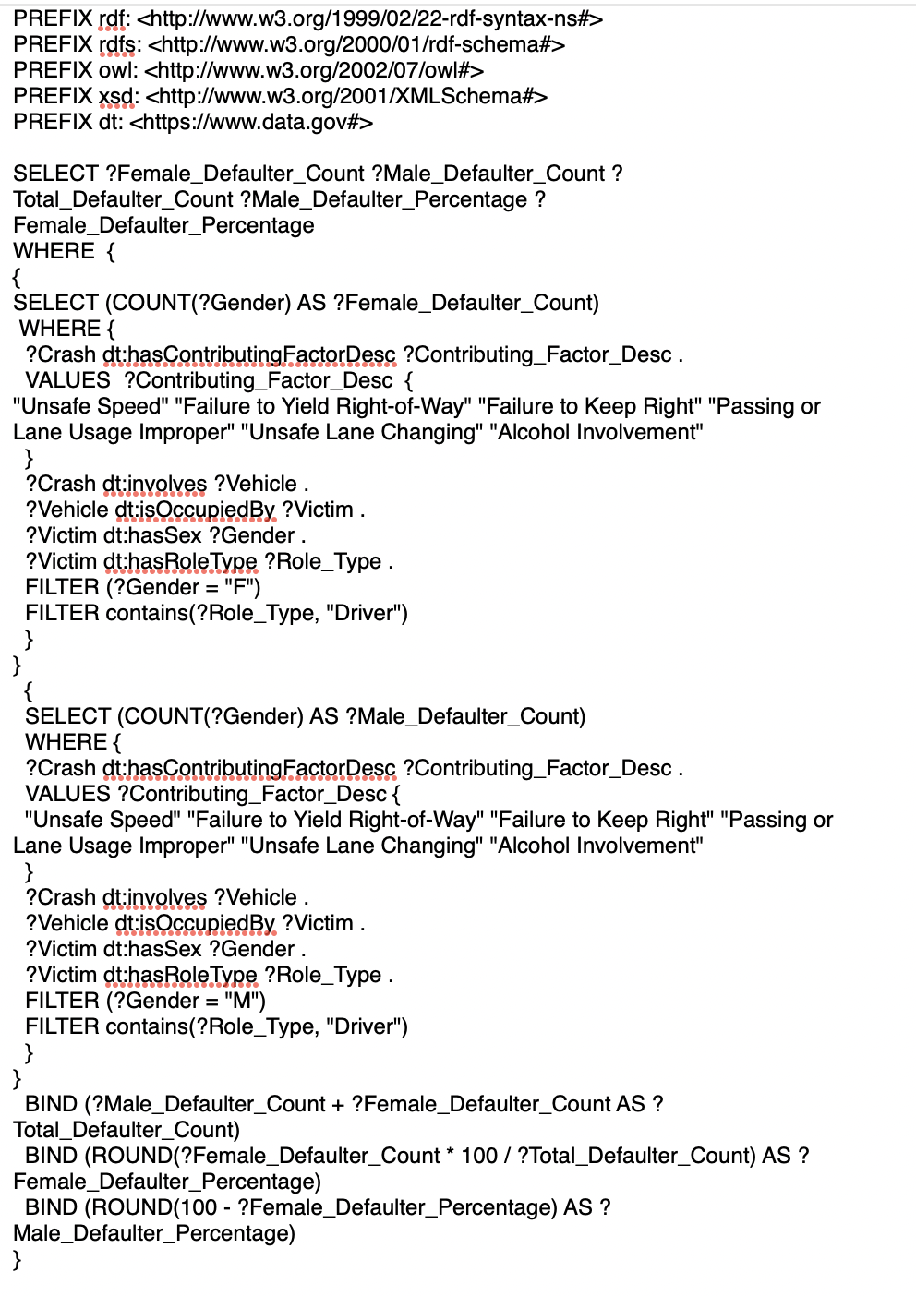
Query 2
In New York State, what percentage of male and female drivers involved in a crash, violated traffic laws in the year 2018?
12

Slide 13
Query 3
PREFIX rdf: <http://www.w3.org/1999/02/22-rdf-syntax-ns#>
PREFIX rdfs: <http://www.w3.org/2000/01/rdf-schema#>
PREFIX dt: <https://www.data.gov#>
PREFIX owl: <http://www.w3.org/2002/07/owl#>
PREFIX xsd: <http://www.w3.org/2001/XMLSchema#>
SELECT ?Contributing_Factor (COUNT(?Contributing_Factor) as ?Total_Count)
WHERE {
?Crash dt:hasContributingFactorDesc ?Contributing_Factor .
?Crash dt:involves ?Vehicle .
?Vehicle dt:isOccupiedBy ?Victim .
?Victim dt:hasAge ?Age .
FILTER (?Age >= "20" && ?Age <= "25")
}
GROUP BY ?Contributing_Factor
ORDER BY desc(?Total_Count)
LIMIT 5
What are the 5 major contributing factors in the state of New York that resulted in crashes among the younger population within the age group 20-25?
13

Slide 14
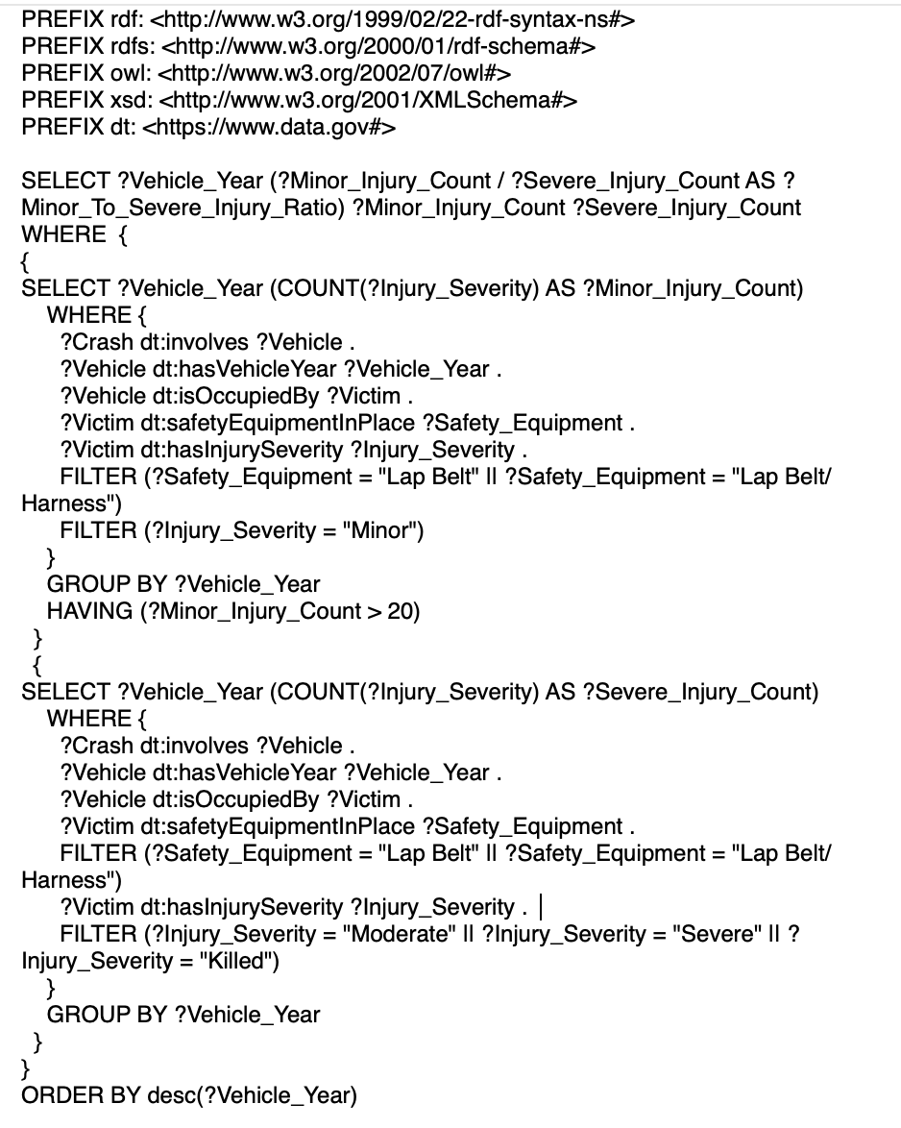
Query 4
Based on the vehicle manufacturing year, what shift has been noticed in the ratio of Minor to Severe injuries when individuals were wearing a seat belt?
14

Slide 15
Technical Challenges
Understanding and Implementing complex SPARQL queries.
Making the project self contained.

Slide 16
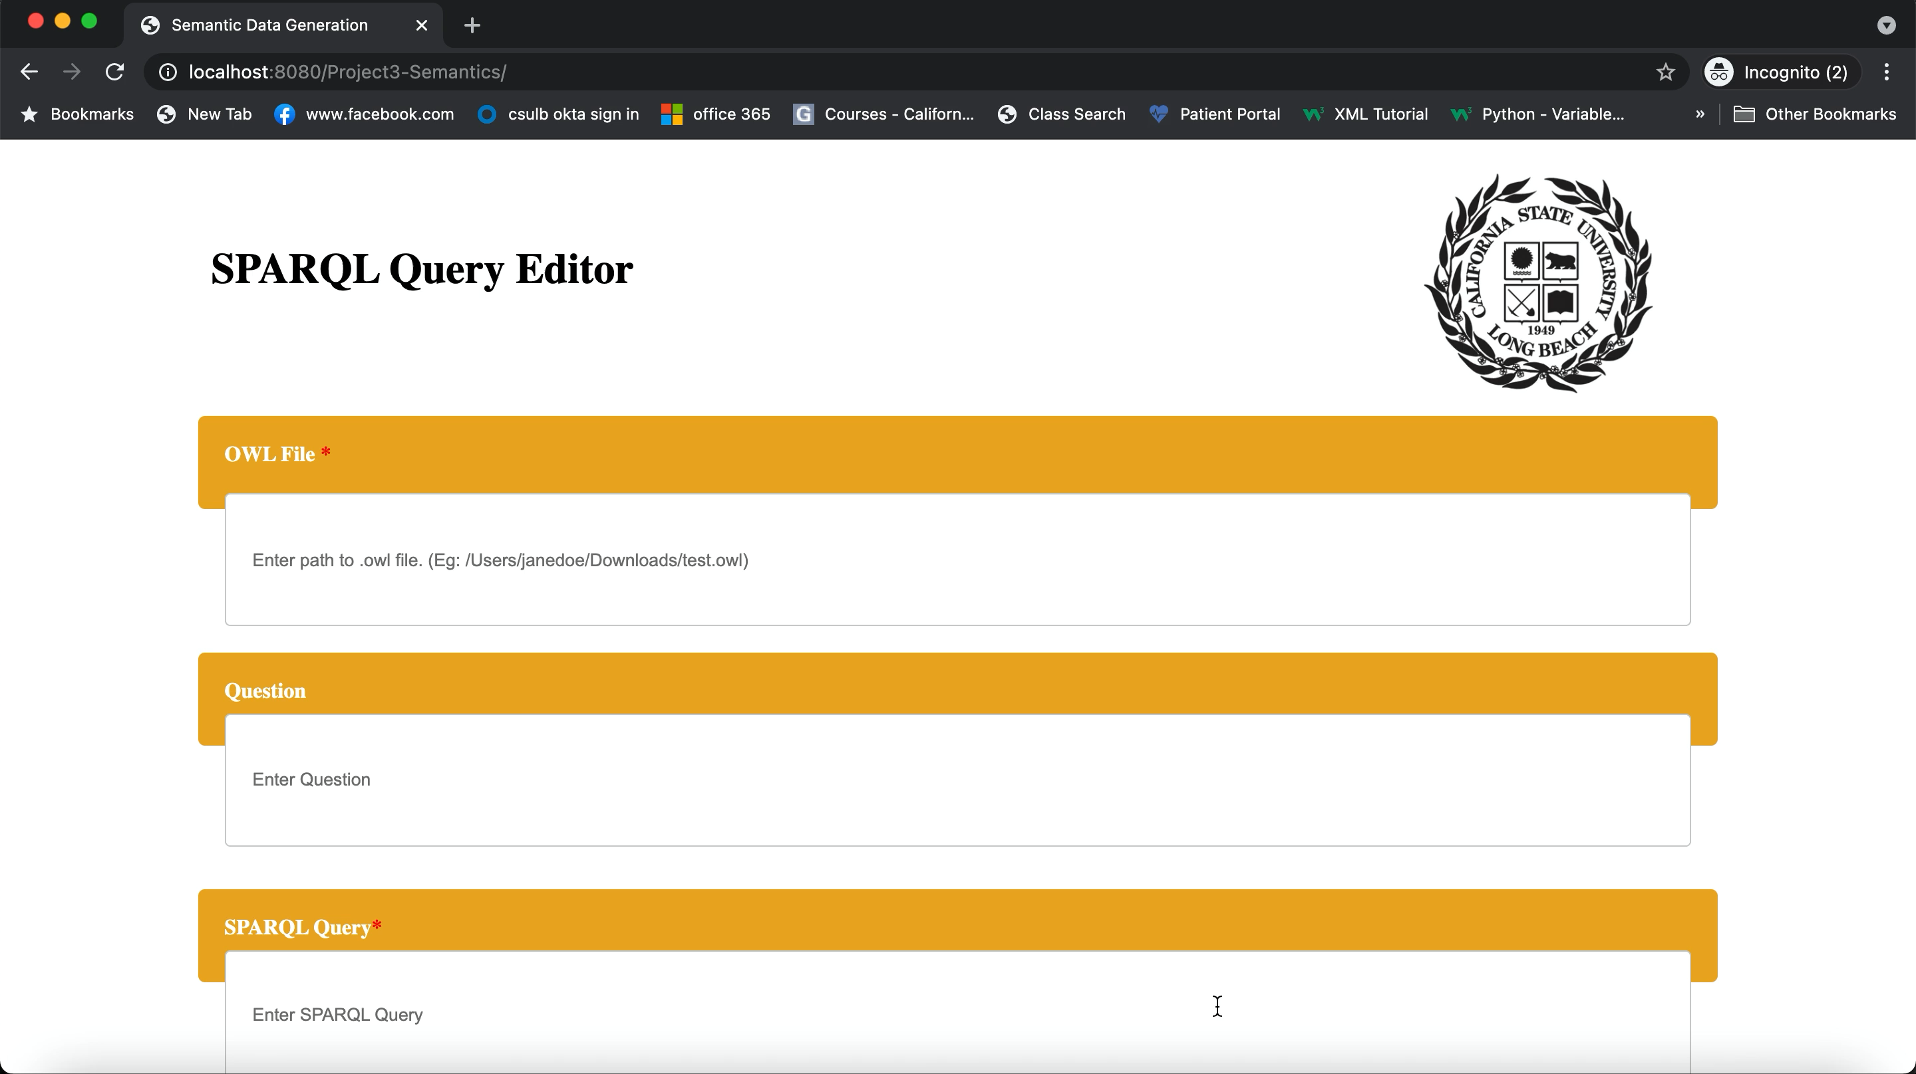

Demo

Slide 17
References
https://en.wikipedia.org/wiki/Jakarta_Server_Pages
https://en.wikipedia.org/wiki/Apache_Tomcat
https://en.wikipedia.org/wiki/Apache_Tomcat#/media/File:Apache_Tomcat_logo.svg
https://en.wikipedia.org/wiki/Apache_Jena
https://www.data.gov/

Slide 18

Thank You!!

Slide 19

Questions?

